Slide 1
Tangent Ratio
EQ: How do I find missing side lengths using cos Ratio?

Slide 2
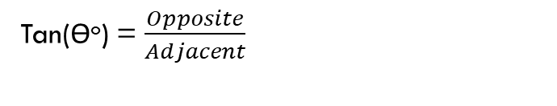
24
7
30
Tangent Ratio
EQ: How do I find missing side lengths using Tangent Ratio?
Tangent Ratio is used when you have the Opposite and Adjacent sides on a right angle triangle.
Remember- the opposite side is always opposite from the angle. The adjacent is the side next to the angle.
OPPOSITE
Tan(ϴº) = $\frac{Opposite}{Adjacent}$
ϴ
Adjacent

Slide 3
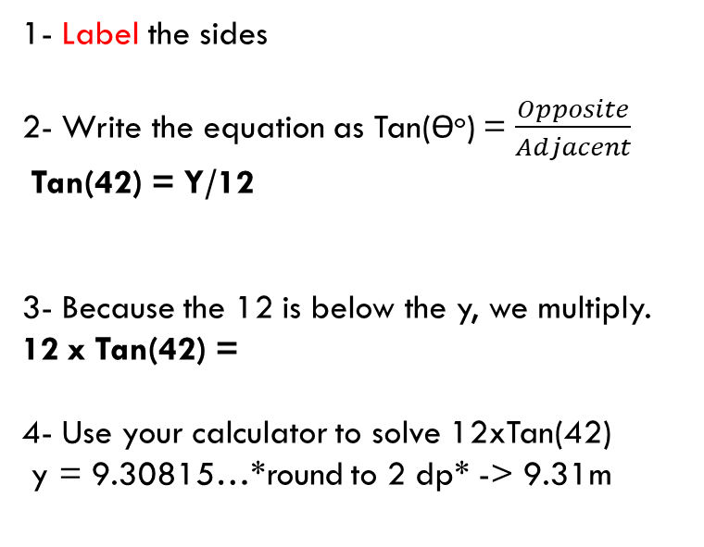
Tangent- Opposite is unknown
EQ: How do I find missing side lengths using Tangent Ratio?
1- Label the sides
2- Write the equation as Tan(ϴº) = $\frac{Opposite}{Adjacent}$
Tan(42) = Y/12
3- Because the 12 is below the y, we multiply.
12 x Tan(42) =
4- Use your calculator to solve 12xTan(42)
y = 9.30815…*round to 2 dp* -> 9.31m
Opposite
Y
42º
12 m
Adjacent

Slide 4
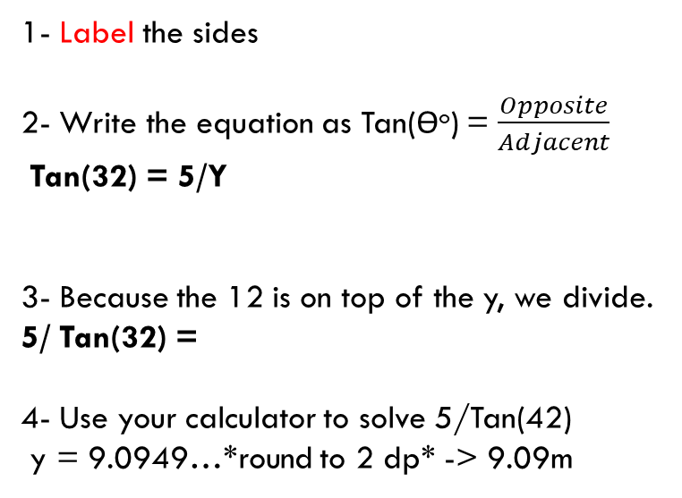
tangent – Adjacent is unknown
EQ: How do I find missing side lengths using Tangent Ratio?
1- Label the sides
2- Write the equation as Tan(ϴº) = $\frac{Opposite}{Adjacent}$
Tan(32) = 5/Y
3- Because the 12 is on top of the y, we divide.
5/ Tan(32) =
4- Use your calculator to solve 5/Tan(42)
y = 9.0949…*round to 2 dp* -> 9.09m
Opposite
5 m
32º
Y
Adjacent

Slide 5
Key information from yesterday
When the number is below the variable – Multiply both sides by the Variable. [TIMES]
When the number is above the variable – Divide the number by (Ratio x Angle). [SWAP]

Slide 6
Practise
Use Tangent to find the missing lengths on these triangles:
Opposite
Adjacent
O
60˚
Tanϴ=
A
42˚
15cm
11cm

Slide 7
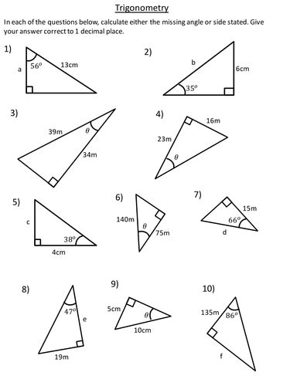

Slide 8
